Slide 1
Currency Derivatives

Slide 2




Table of Contents

Slide 3

Indian Foreign Exchange Markets
INR trades in a managed floating exchange rate regime
INR is fully convertible on India’s current account, but not on the capital account
Foreign institutional investors can fully repatriate their investments
Resident Indian individuals have been permitted to invest offshore
All foreign currency spot and forward transactions need to be routed through schedule commercial banks (Authorized Dealers)
Access is restricted to banks and entities having a commercial exposure
Volumes and tenor is restricted to underlying exposure
Only banks have open position limits
Notes:
Repatriate: The process of converting a foreign currency into the currency of one's own country

Slide 4

Indian Foreign Exchange Markets
Daily average turnover of the Indian FX markets stands at USD 34 billion
Flows driving the USDINR rate include;
  Trade and capital flows
  Hedging of these flows by corporate and institutional clients
  Remittances by non resident Indians
  Investments by offshore institutions in India
  Investment by Indian companies offshore
  Directional views of market participants
India’s total imports: USD 250 billion, exports USD 160 billion (FY 2007-08)
Capital flows, FIIs USD 31 billion, Foreign Direct Investment USD 15 billion, Bank Capital USD 11 billion

Slide 5
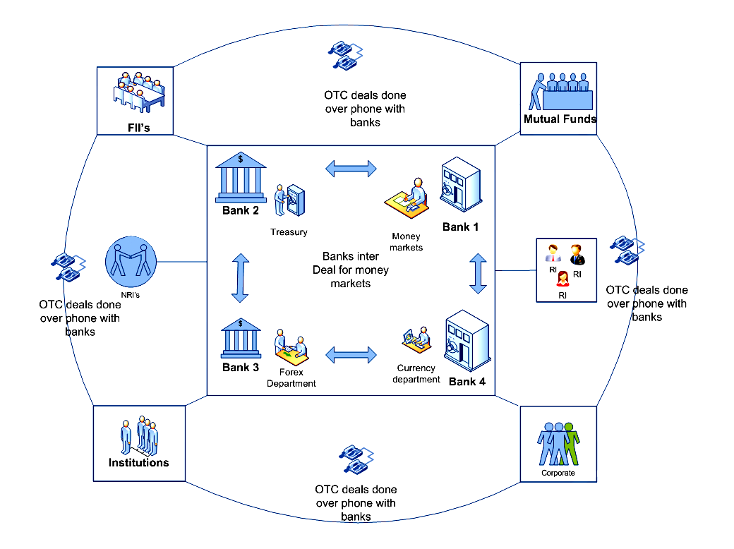
Indian Foreign Exchange Markets - Participants

Slide 6
Why do they participate in the FX market ?
Directional Views
  Positioning for INR appreciation or depreciation
Hedging existing exposure
  Importers & Exporters hedging future payables or receivables
  Borrowers hedging FCY loans – interest or principle payments
  NRIs looking to hedge their investment in India
  Resident Indians looking to hedge investments offshore
  FIIs hedging their investments in India
Trade and Capital Flows
  Remittances for trade or services and capital transactions
Arbitrage
  Entities who can access onshore and non deliverable forward markets

Slide 7
What factors affect trading decisions ?
Macro economic views
Monetary Policy
RBI intervention
Flow information
Performance of other Asian currencies
Performance of equity markets
USD sentiment
Performance of key commodities affecting trade
Policy announcements affecting flows – trade or capital
REER – Real Effective Exchange Rate
Data announcements

Slide 8
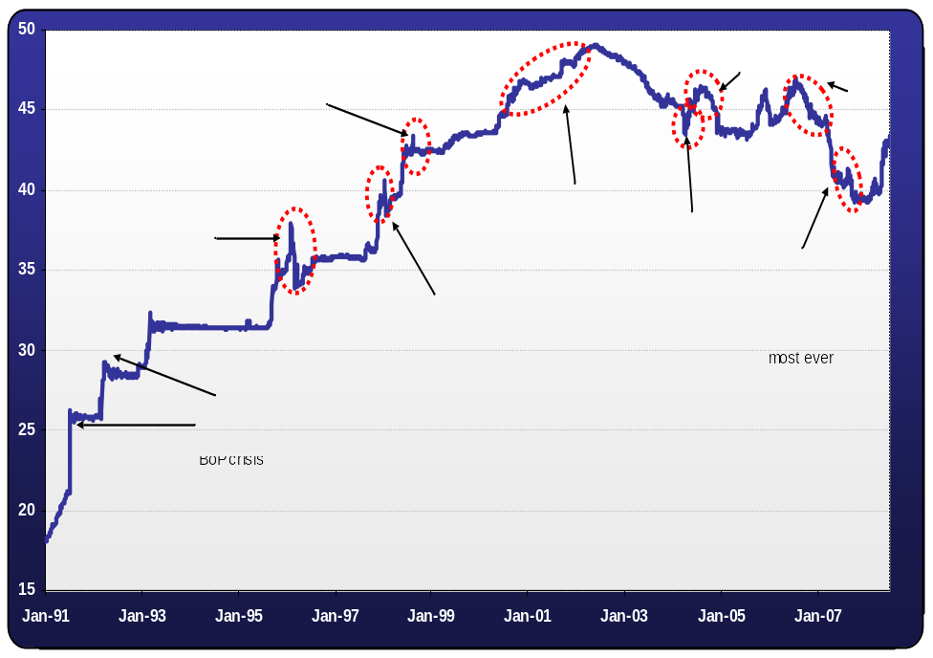

Trading Strategies – Directional views
1991: BOP crisis
1998: Nuclear tests
2001: Nasdaq crash
2003: Strong FII flows
2004: BJP election loss
2006: Drop in RBI intervention
2008: Oil spikes

Slide 9
Trading Strategies – Directional views
View: INR will depreciate against USD, caused by India’s sharply rising import bill and poor FII equity flows
Trade:
USDINR 31 July contract: 43.5000
Current Spot rate (9 July 08): 43.0000
Buy 1 July contract: Value Rs. 43,500 (USD 1000 * 43.5000)
Hold contract to expiry:RBI fixing rate on 29 July 08 – 44.0000
Economic return:Profit, Rupees 500 (44,000 – 43,500)
A Currency Futures contract is exactly like a futures contract on the NIFTY or on INFOSYTCH. A futures price “F” is traded on screen. The price is the USDINR exchange rate at a future date.

Slide 10
Trading Strategies - Hedging
IT exporter - contract earning USD 1 million per month for 12 months
Risk to INR appreciation
Trade - Sell 1000 contracts of each expiry out to 12 months
On each expiry sell the USD remittance in the spot market and match the rate to the fixing rate on the futures contract
Follow this principal if you continue to hold the same view through the life of the service contract

Slide 11
Trading Strategies - Hedging
Individual investor invested USD 100,000 in equities offshore
Purchased USD by paying INR 4,300,000 (Spot @ 43.0000)
At the end of 12 months; offshore portfolio valuation is USD 110,000 and USDINR is trading at 40.0000
Net INR proceeds INR 4,400,000
USD return of 10%, your INR return is only 2.33%
Alternate strategy: hedge the initial investment, by selling the 12 month futures contract at the time of trade inception

Slide 12
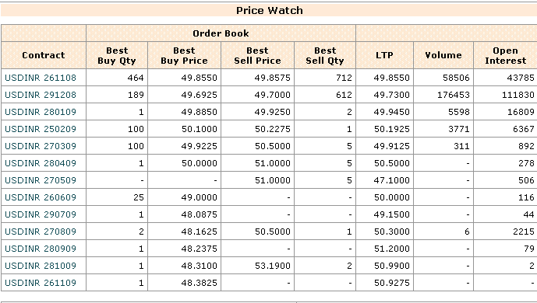
Contract Description
Notes:
Open Interest is the total number of outstanding contracts that are held by market participants at the end of the day.
It can also be defined as the total number of futures contracts or option contracts that have not yet been exercised (squared off), expired, or fulfilled by delivery.

Slide 13
Trading Strategies - Arbitrage
Arbitrage can potentially exist between, currency futures, OTC forwards and the non-deliverable forwards traded offshore
An arbitrage can be executed by an entity having access to any two of the above
Corporate entities with an underlying exposure, can straddle both markets
  Sell 1st month in currency futures
  Buy 1 month forward in OTC markets
This scenario can exist when currency futures are trading higher than forwards which will also be governed by interest rate differentials and USD supply with banks
Restricted access to the OTC and NDF markets could translate to the arbitrage gap not closing.

Slide 14
OTC vs Futures
 | OTC Market | Exchange Traded Futures
Accessibility | Low | High
Price Transparency | Low | High
Liquidity | Subject to credit limits | High
Agreements | Customized | Standard
Credit Exposure | Yes | Mitigated through the clearing corporation
Settlement | Physical Delivery | Net Settled in INR
Underlying exposure | Required | Not required

Slide 15
OTC vs Futures
Will it trade like OTC forwards
  INR not fully convertible
  Regulatory restrictions on borrowing in foreign currency
  Delivery vs net settlement
  Wider set of market participants
  RBI intervention
The Non Deliverable Forwards market does not always track onshore OTC forwards, especially at the short end
  Sharp moves in spot
  Expectations of immediate INR appreciation / depreciation
  Flow information

Slide 16
Contract specifications
Category | Description
Underlying | Rate of exchange between 1 USD and INR
Contract Size | USD 1000
Contract Months | 12 near calendar months
Expiration Date and Time | Last business day of the month
Min Price fluctuation | 0.25 paise or INR 0.0025
Settlement | Cash settled in INR on relevant RBI reference rate
Market timings would be 09:00 to 17:00
Order driven market
Contract fixing two days prior to Contract Expiration date, settlement on contract expiry date

Slide 17
Risk Management
Real time Upfront portfolio based margins
Based on 99% VaR
Client level monitoring
Initial Margin
  Margins calculated using SPAN
  Minimum Initial margin 1.75% on day 1, 1% thereafter
  Calendar spread margins defined at Rs. 250/-
  Monitored at Trading and Clearing Member level

Slide 18
Risk Management
Extreme Loss Margin
  1% on value of gross open positions
  Monitored at Clearing Member level
Positions Limits
  Client : 6% of total open interest or USD 5 million whichever is higher
  Trading member : 15% of total open interest or USD 25 million whichever is higher

Slide 19
Clearing & Settlement
Daily Clearing and Settlement
  Trades processing
  Position computation
  Daily settlement price
  Mark to market settlement
  Client margin reporting
Final Clearing and Settlement
  Expiry day processing
  Final settlement price
  Final settlement of futures contracts

Slide 20
Membership
Separate membership for the Currency Derivatives Segment
Balance sheet networth: Trading member Rs. 1 Crore; Clearing member Rs 10 crores
Minimum Liquid Networth for clearing members Rs. 50 Lakhs
Separate Certification required
Members to be approved by SEBI
Foreign Institutional Investors and Non Resident Indians not permitted to trade in the initial phase

Slide 21
Membership
Deposits for Existing Members:
In Rupees Lakhs | Trading Member | Trading and Clearing Member
Interest free cash security deposit with NSEIL | 10 | 10
Interest free cash security deposit with NSCCL | NIL | 25
Collateral Security Deposit with NSCCL | NIL | 25
For every trading member, clearing member needs to provide
Cash | NIL | 5
Non - Cash | NIL | 5

Slide 22
Thankyou

